Slide 1
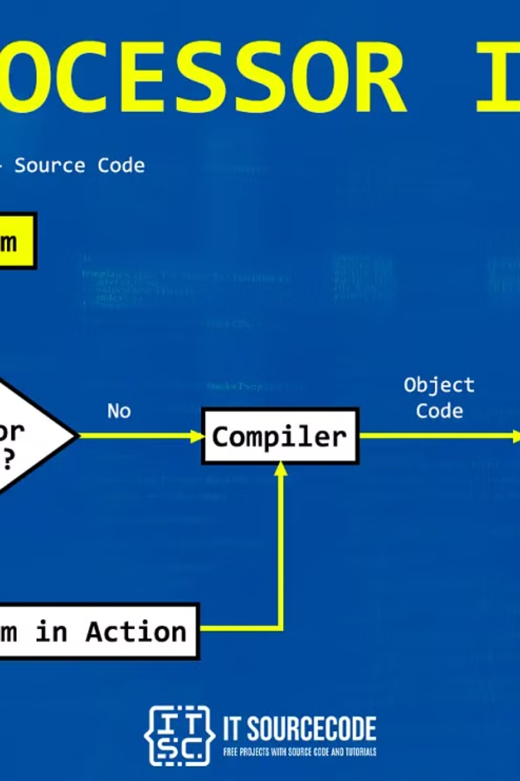
What are preprocessors?
Preprocessors in C are programs that process the source code before it is passed on to the compiler. They perform various tasks such as macro expansion, file inclusion, and conditional compilation. One of the most commonly used preprocessors in C is the #include directive, which allows code from other files to be inserted into the current file. This facilitates modular programming and code reusability. Another important preprocessor is the #define directive, which allows symbolic constants to be defined for use throughout the code. Additionally, preprocessors can be used for conditional compilation, where certain parts of the code are included or excluded based on predefined conditions.
Preprocessors play a crucial role in simplifying and organizing C code, making it more maintainable and easier to work with. By understanding and effectively utilizing preprocessors, developers can enhance the clarity, flexibility, and efficiency of their C programs.

Slide 2

Purpose of preprocessors in C
Facilitate Code Reusability: Preprocessors in C help in reusing code segments by allowing the inclusion of header files and defining macros.
Conditional Compilation: They enable conditional compilation, allowing different code segments to be included or excluded based on certain conditions.
Language Extension: Preprocessors expand the functionality of the C language by providing additional
features and capabilities.

Slide 3

Commonly used preprocessors in C
#include directive: This preprocessor directive is widely used in C to include the contents of a file into the source code. It allows for modular programming and reusability of code.
#define directive: Another frequently used preprocessor directive, it is used to define constants or macros, providing flexibility and better code readability.
#ifdef and #ifndef directives: These directives are essential for conditional compilation, allowing specific code blocks to be included or excluded based on defined conditions, enhancing code flexibility.

Slide 4
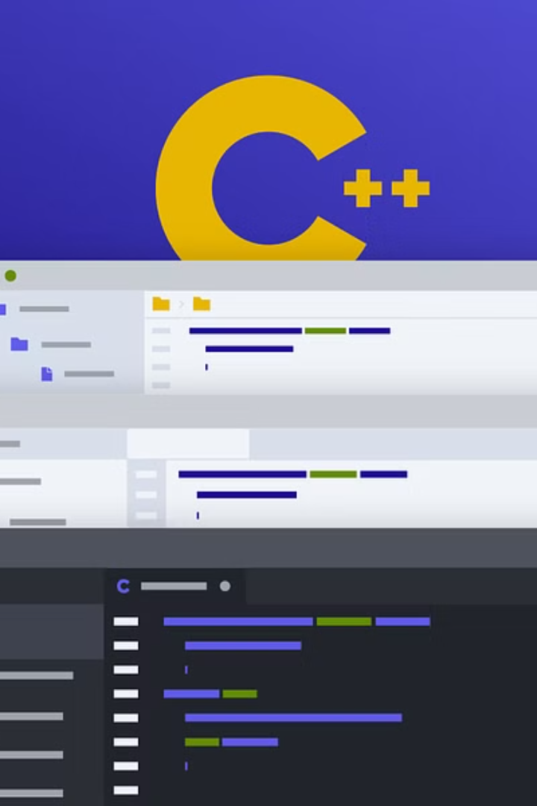
#include directive
The #include directive is a preprocessor directive in C that is used to include the contents of a file in the source code of a program. This allows the programmer to use external files, typically header files, containing declarations and definitions of functions and variables, in their program. The #include directive is essential for modularizing the code and making it more organized and maintainable.
By using the #include directive, the programmer can easily reuse code across multiple files, improving code reusability and reducing duplication. It plays a crucial role in separating interface and implementation, promoting the concept of encapsulation in C programming.

Slide 5

#define directive
The #define directive in C is used to define a macro, which is a symbolic name or identifier for a constant value or expression. This allows the programmer to create their own symbolic names for values, making the code more readable and easier to maintain. The #define directive is very commonly used for defining constants, such as mathematical values, array sizes, or other fixed values that are used throughout the program.
Using the #define directive can also improve the efficiency of the program by replacing literal values with symbolic names, which can be easier for the compiler to optimize. Additionally, it can make the code more flexible by allowing the programmer to easily change the value of a constant throughout the program by modifying the #define directive.

Slide 6
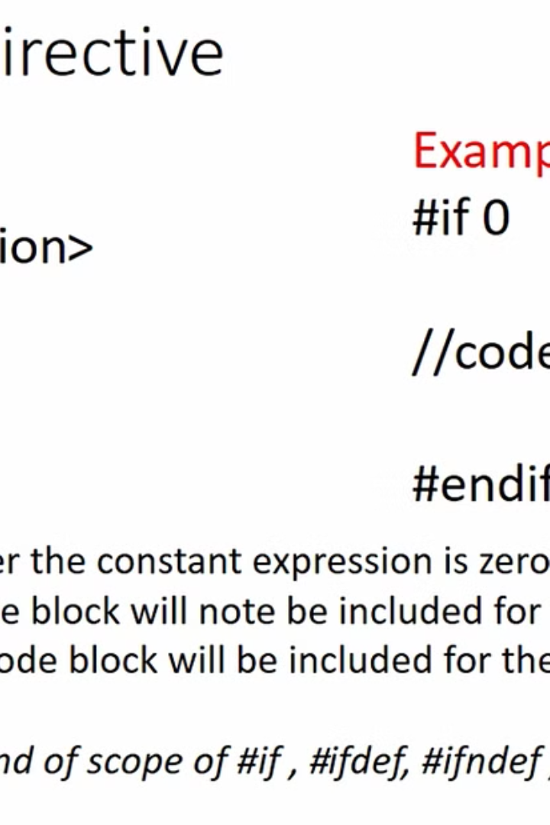
#ifdef and #ifndef directives
In C programming, the #ifdef and #ifndef directives are used to conditionally include or exclude a block of code from compilation. The #ifdef directive checks whether a macro is defined and includes the code if the macro is defined. In contrast, the #ifndef directive includes the code if the specified macro is not defined.
These directives are commonly used to create platform-independent code, allowing different code blocks to be compiled based on the presence or absence of certain macros. They are also useful for debugging, as specific code segments can be included or excluded based on the defined macros.

Slide 7
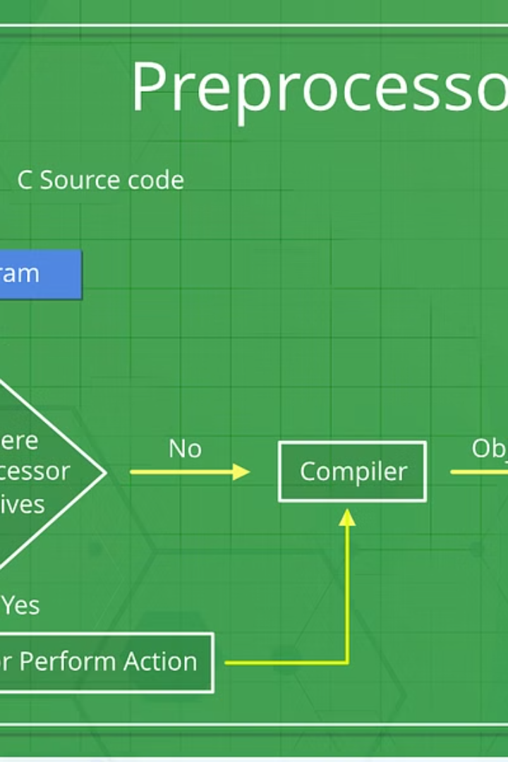
#pragma directive
The #pragma directive in C is a preprocessor directive that provides a way to pass information to the compiler. It can be used for various purposes, such as enabling specific compiler features, controlling optimization settings, or issuing warnings and errors. This directive is often used to customize the behavior of the compiler and to optimize the code for specific platforms or environments.
Developers commonly use #pragma directives to fine-tune the compilation process, align memory, specify packing for structures, and enable or disable certain compiler warnings. It's important to note that the exact behavior and availability of #pragma directives can vary between different compilers and platforms, so it's essential to consult the compiler's documentation for specific details.

Slide 8
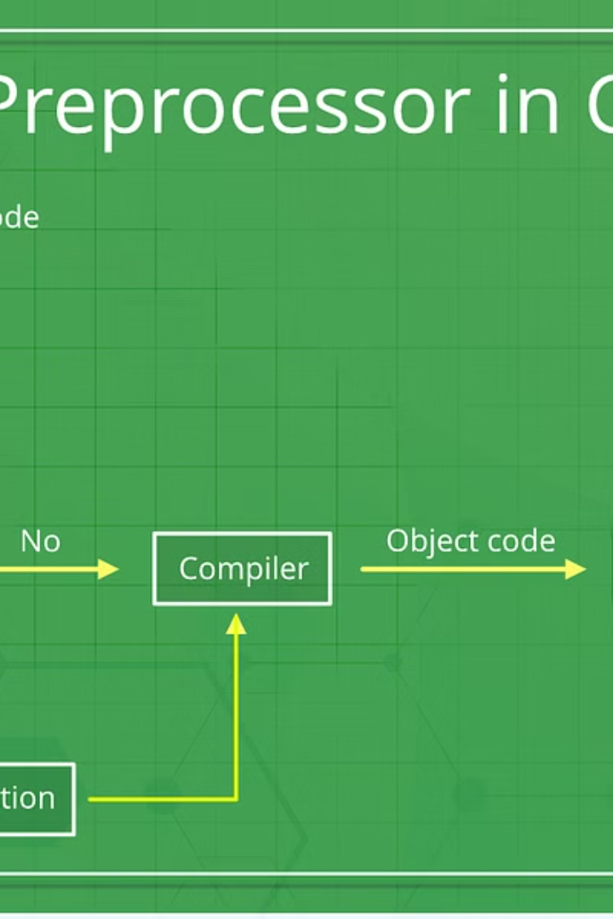
Preprocessor Macros
In C programming, preprocessor macros are a powerful feature that allows for the definition of constant values and for the creation of code that behaves like functions. These macros are defined using the #define directive and are used to make the code more readable, maintainable, and adaptable. They enable developers to define symbolic names or constants that can be used throughout the code, improving code organization and reducing the chances of errors.
Preprocessor macros are commonly used to define constants for calculations, create standard header files, and simplify complex logic. They provide a way to develop reusable code and enhance the overall efficiency of the program. Additionally, they play a crucial role in conditional compilation, where different sections of code may be included or excluded based on certain conditions at compile time.

Slide 9
Advantages of Using Preprocessors in C
Code Reusability
Conditional Compilation
Preprocessors in C allow for the reuse of code through the #include and #define directives. This promotes modular programming and reduces redundant code, improving maintainability and readability.
The #if, #ifdef, and #ifndef directives enable conditional compilation, allowing different parts of the code to be included or excluded based on defined conditions. This flexibility enhances portability and customization options.
Configuration Management
Enhanced Readability
Preprocessors facilitate the management of configuration parameters, such as feature flags and version information, at compile time. This flexibility simplifies the process of customizing software for different environments or requirements.
By abstracting complex or repetitive code into macros and header files, preprocessors contribute to improved code readability, making it easier for developers to understand and maintain the codebase.

Slide 10

Best Practices for Using Preprocessors in C
When working with preprocessors in C, it's crucial to adhere to best practices in order to ensure efficient and maintainable code. One of the key best practices is to use preprocessor directives judiciously and avoid overuse, as excessive reliance on preprocessors can lead to code that is difficult to understand and debug. Additionally, it's important to use meaningful and descriptive names for preprocessor macros, making the code more readable and comprehensible for other developers.
Furthermore, it's recommended to avoid placing complex logic within preprocessor macros, as this can hinder code readability and maintainability. Instead, utilize functions and inline functions where appropriate. Another best practice is to keep preprocessor directives and macro definitions close to where they are used, enhancing code organization and clarity.
Moreover, it's essential to thoroughly test code that relies heavily on preprocessors, as errors in preprocessor directives or macros can have significant and wide-reaching impacts on the entire codebase. Finally, documenting the usage of preprocessors and providing clear explanations for their necessity can greatly aid in the maintenance and future development of the codebase.

